Slide 1





Data Derby 2023 - Datathon Team Ten (10)
1
Manidweep Sharma
Ricardo de Deijn
Syed Shuja Hasan
Syeda Lamima Farhat

Slide 2
2
Table of Content
Our findings regarding food price trends
Our CPI and PPI with food price correlation findings
Extra insights we gathered
Our forecast of the food price

Slide 3
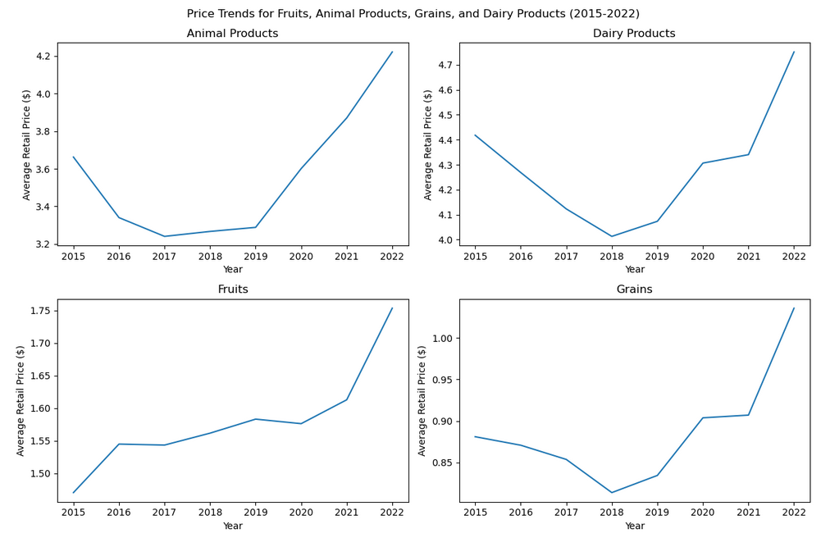
Our Findings Regarding Food Price Trends Question 1
3

Slide 4
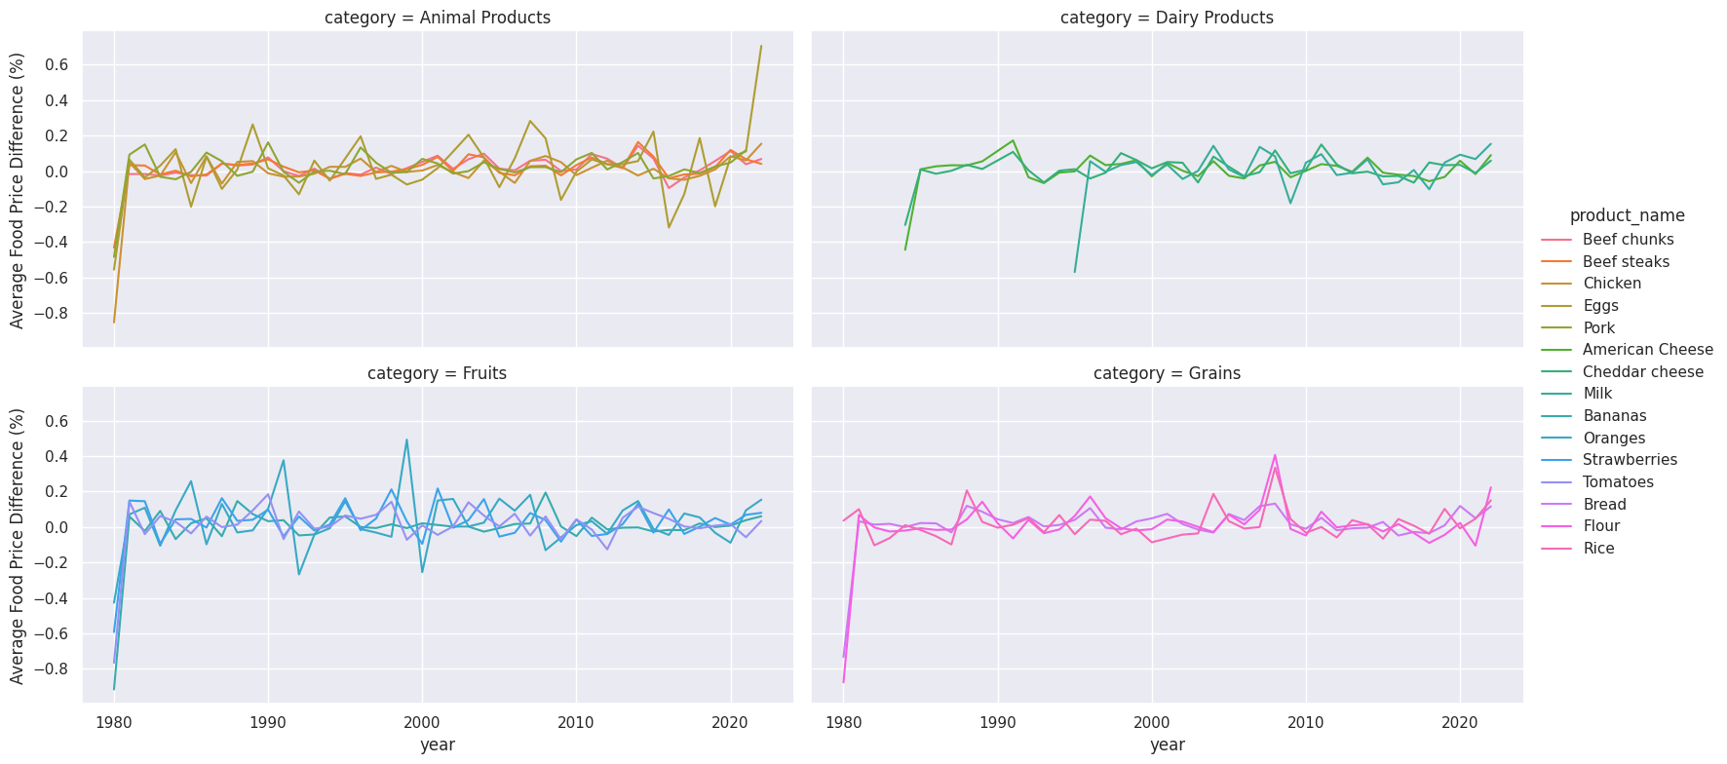
Our Findings Regarding Food Price Trends Question 2
4

Slide 5
Our Findings Regarding Food Price Trends Question 3
5

Slide 6
Our Findings Regarding Food Price Trends Question 3
6

Slide 7
Our Findings Regarding Food Price Trends Question 3
7

Slide 8
Our Findings Regarding Food Price Trends Question 3
8

Slide 9
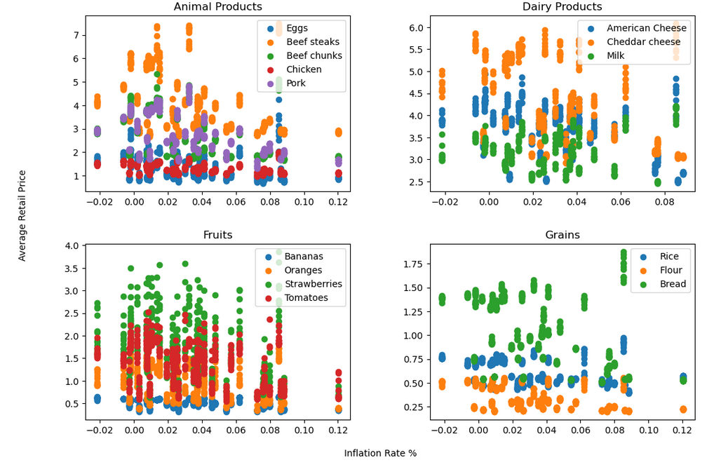
Our CPI / PPI / Food Price Correlation Findings Question 4
9

Slide 10
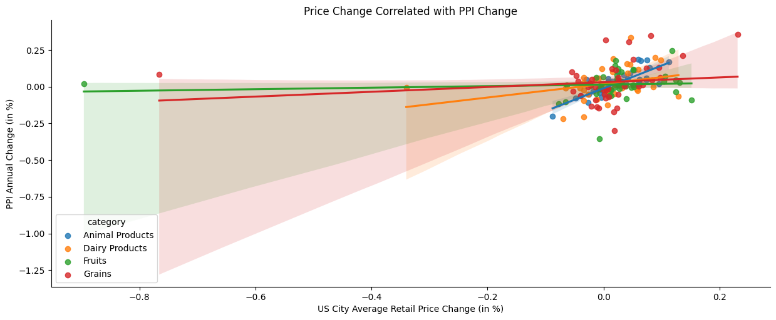
Our CPI / PPI / Food Price Correlation Findings Question 5
10

Slide 11
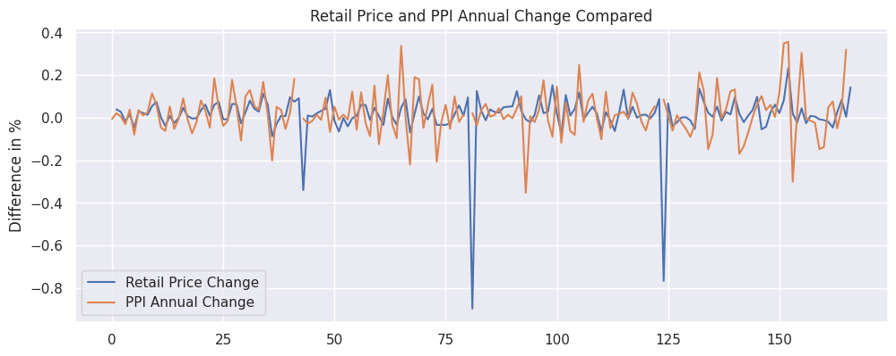
Our CPI / PPI / Food Price Correlation Findings Question 5
11

Slide 12
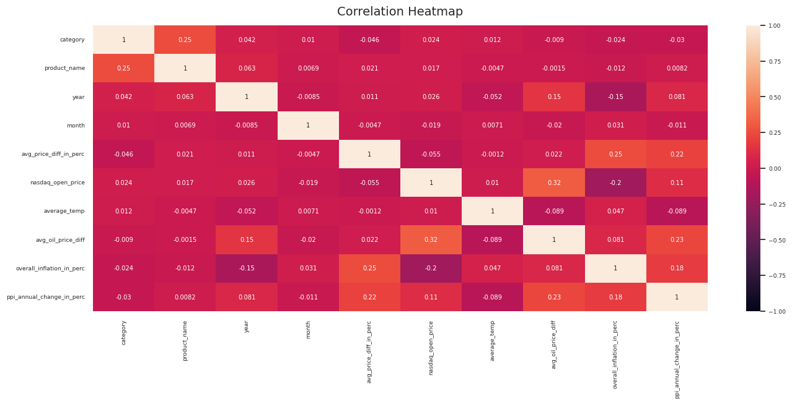
Extra Insights Variable Heatmap
12

Slide 13
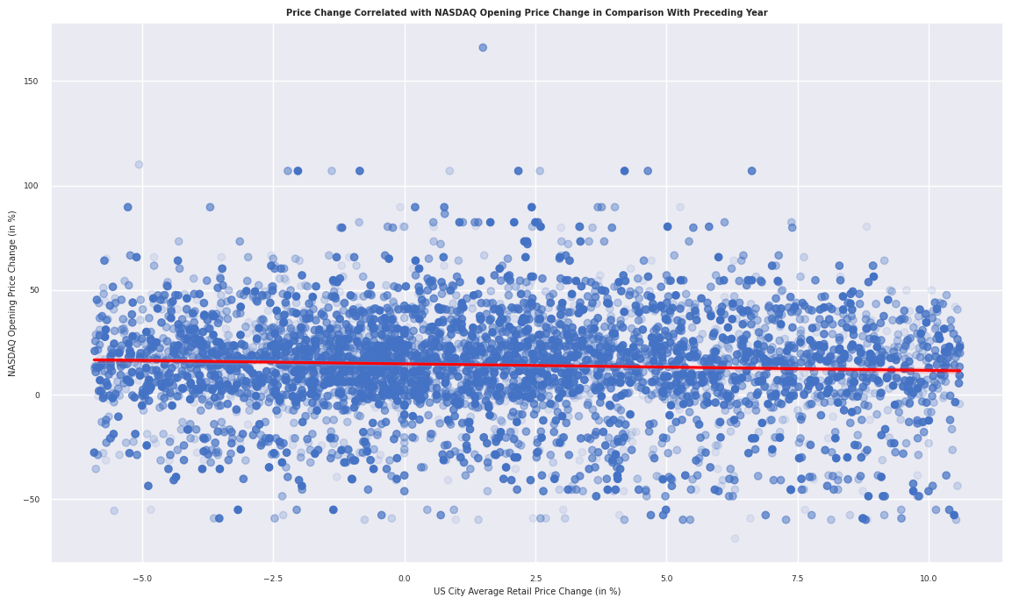
Extra Insights Monthly NASDAQ Opening Price Increase Rate (Compared to Preceding Year)
13

Slide 14
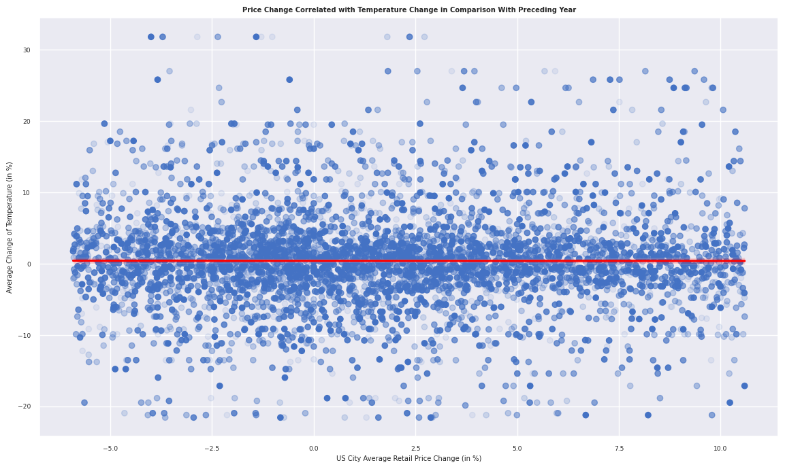
Extra Insights Monthly Temperature Increase Rate (Compared to Preceding Year)
14

Slide 15
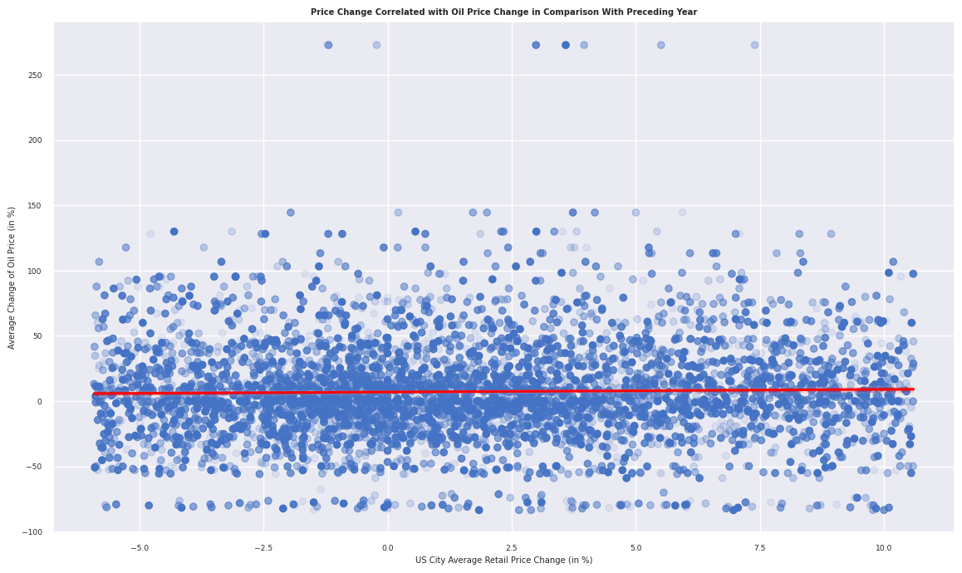
Extra Insights Monthly Oil Price Increase Rate (Compared to Preceding Year)
15

Slide 16
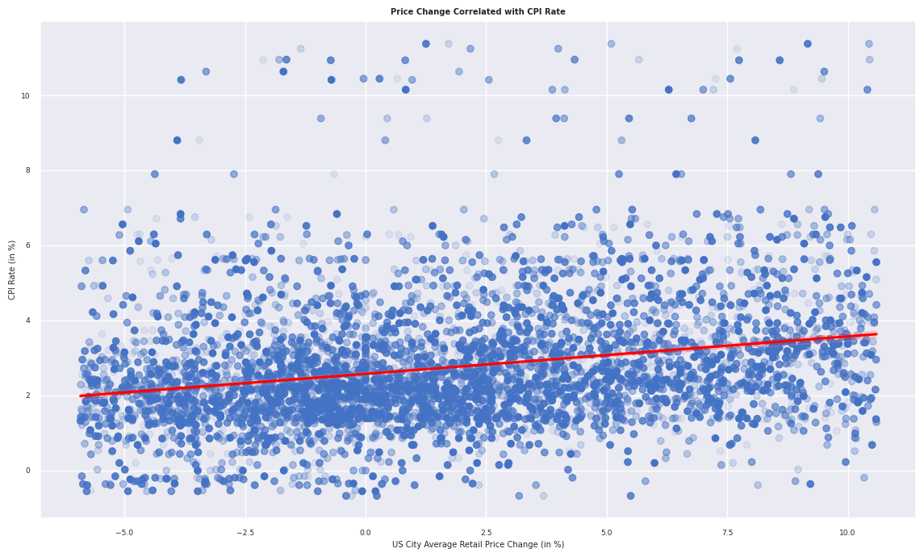
Extra Insights Monthly Inflation Rate for Food Price (Compared to Preceding Year)
16

Slide 17
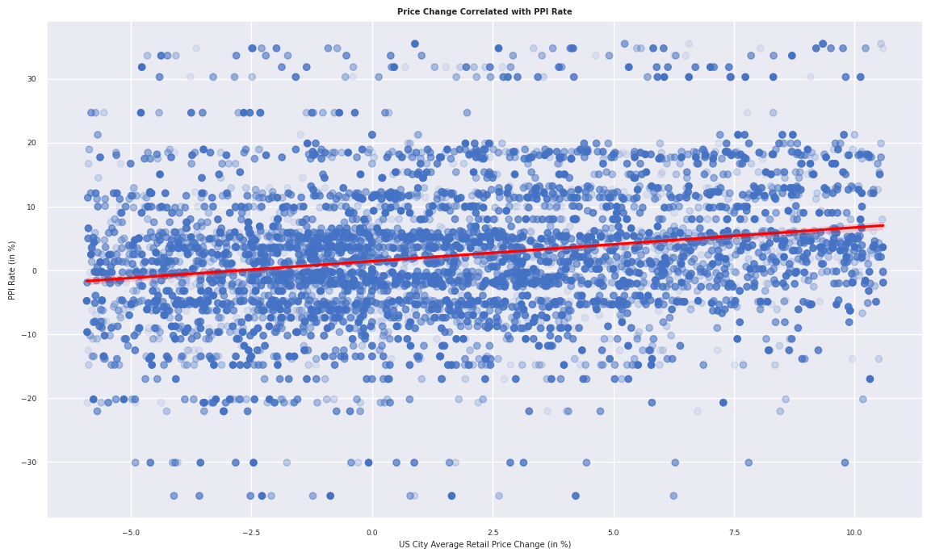
Extra Insights Production Cost Inflation Rate (Compared to Preceding Year)
17

Slide 18
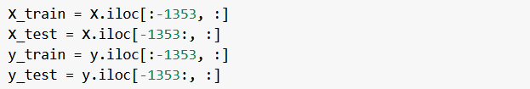
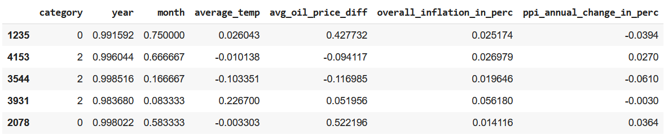
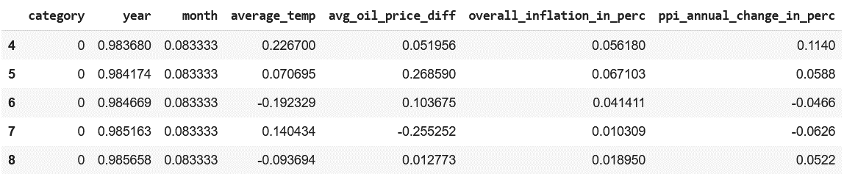
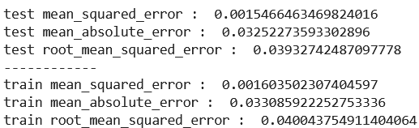
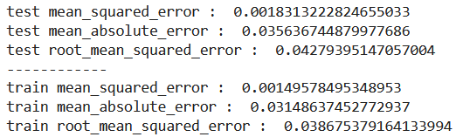
Our Food Price Forecast Question 6
18

Slide 19
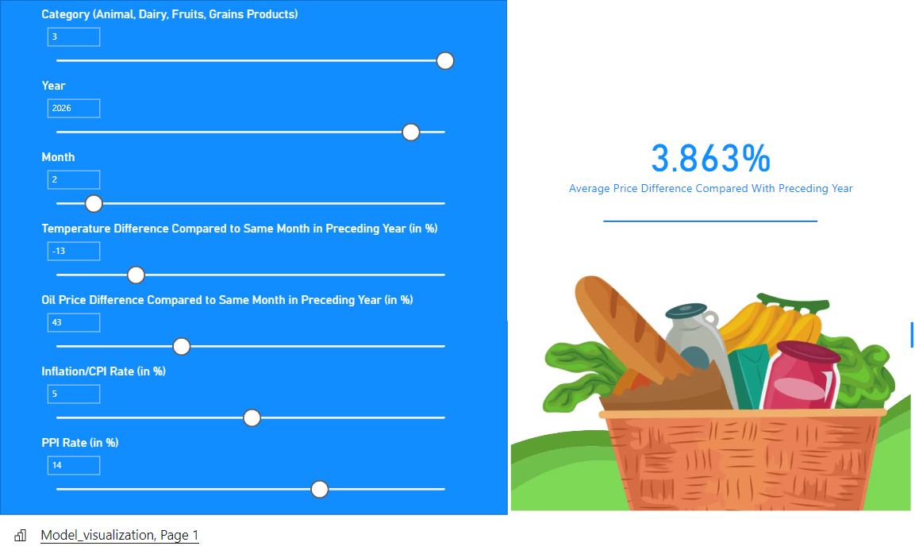
Our Food Price Forecast Question 6
19
Image retrieved from
https://listonic.com/basic-grocery-list/

Slide 20
Thank you for your attention
20
Do you have any questions for us?

Slide 21
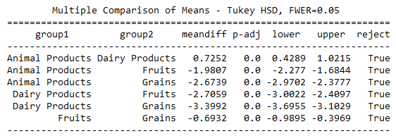
Appendix I Statistical Comparison of Means for Question 1
21

Slide 22
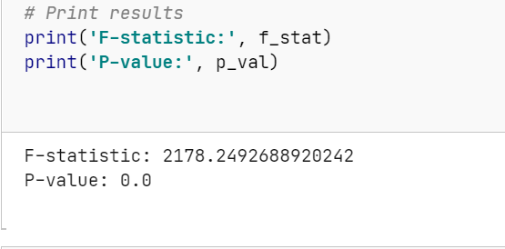
Appendix II Statistical Comparison of Means for Question 2
22

Slide 23
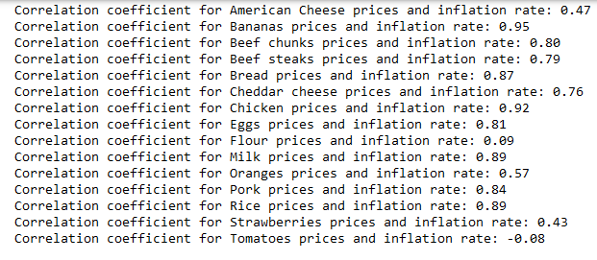
Appendix III Correlation coefficients for Question 4
23

Slide 24
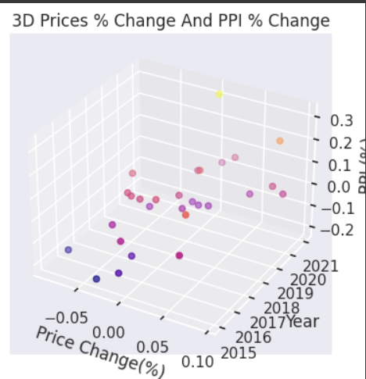
Appendix IV 3D Scatterplot for Question 5
24

